Slide 1
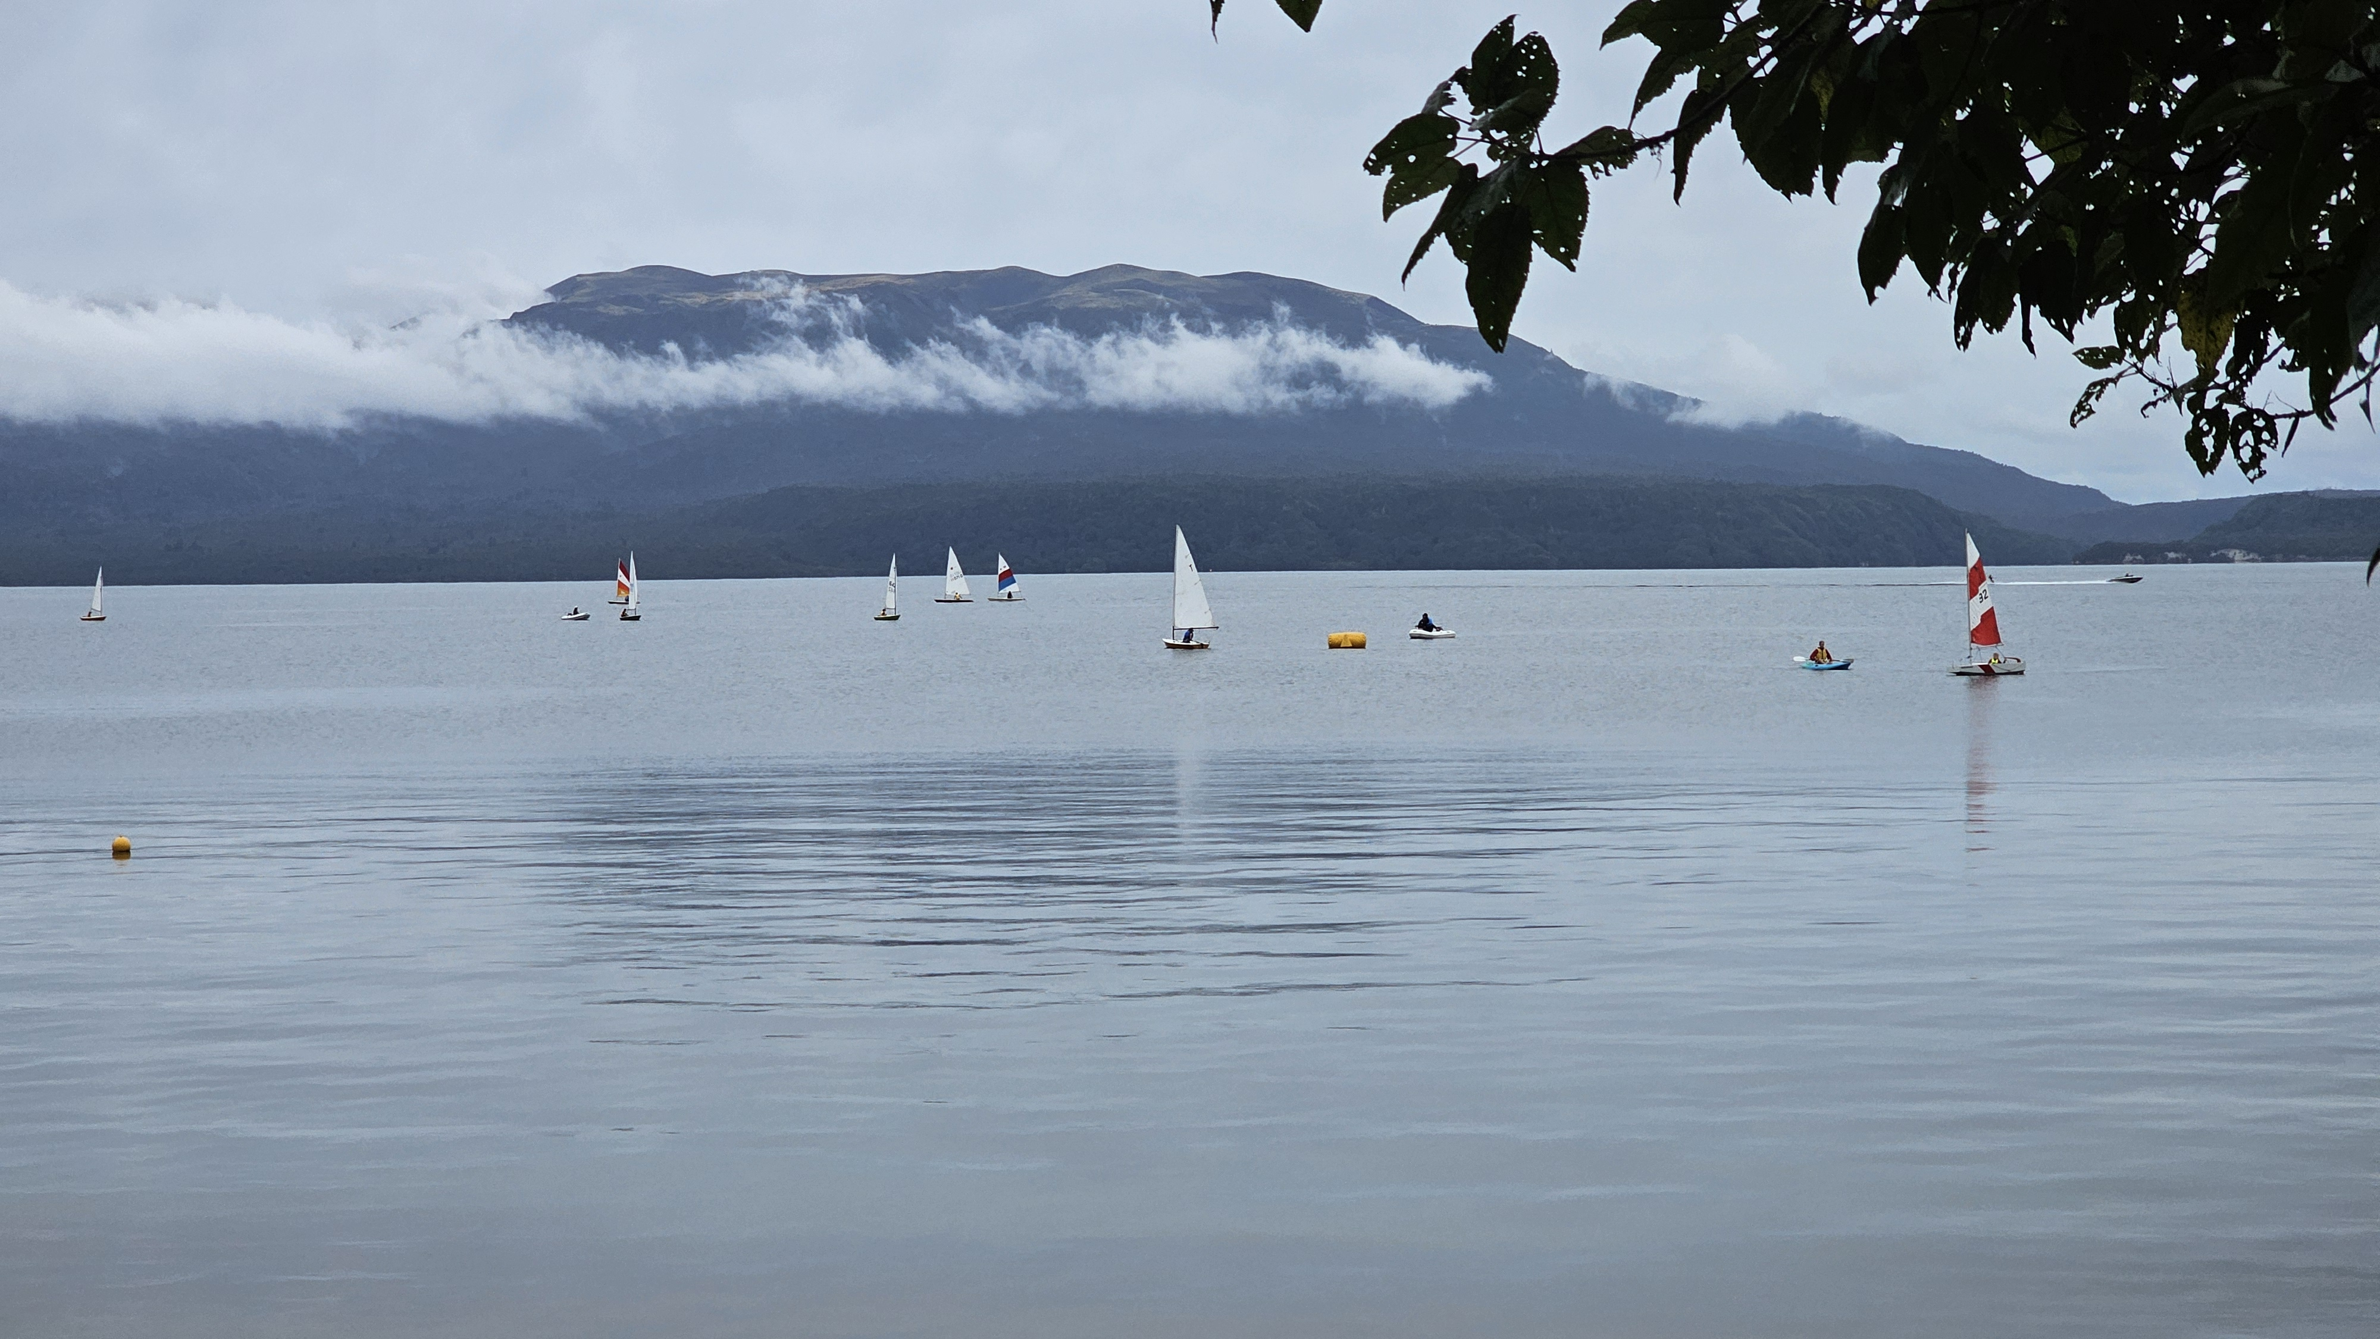

Slide 2
Purpose of LTRA Submission
Funding for the Lake Tarawera Wastewater Reticulation Scheme
Our submission is that the total value of funding from both local councils and central government should be adjusted to re-establish the property owners share at no more than 50% of the project cost, and that RLC contributes additional funding to help make this possible.

Slide 3
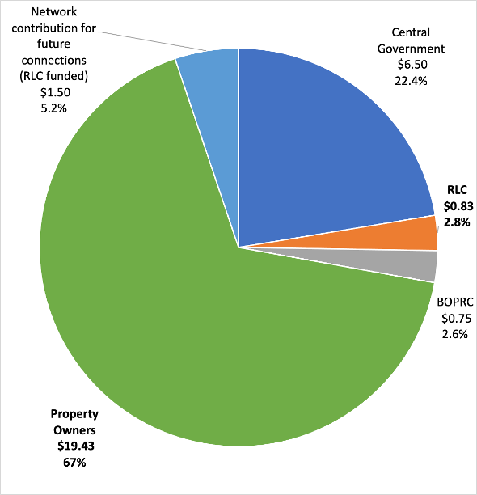
Current Funding
The cost of the project is $29m.
Existing subsidies from RLC, BOPRC and central government total $8.1m.
The 446 property owners would fund 67% of the project cost.
That is approx. $50,000 per property (including GST).

Slide 4
Lake Tarawera Wastewater Reticulation Scheme Cost and Funding
 | Cost | Stage | RLC Contribution | Property Owner Contribution
2014 | $13.8m | Feasibility
2018 | $15m - $19m | Funding established | 5.5% - 4.3% | 42% - 52%
2021 | $22.5m | Proposal to Owners | 3.7% | 57%
2024 | $29m | Committed contracts | 2.8% | 67%

Slide 5
Lake Tarawera Wastewater Reticulation Scheme Cost and Funding
 | Cost | Stage | RLC Contribution | Property Owner Contribution
2014 | $13.8m | Feasibility
2018 | $15m - $19m | Funding established | 5.5% - 4.3% | 42% - 52%
2021 | $22.5m | Proposal to Owners | 3.7% | 57%
2024 | $29m | Committed contracts RLC Funding Policy adjusted to $2700 per property | 2.8% 5.1% | 67% 65%

Slide 6
Further matters to be considered by RLC in allocating funding to the scheme
Council has a fundamental and statutory role in promoting the social, economic, environmental and cultural well-being of communities in the present and in the future.
It is hard to imagine a funding initiative that better aligns with this role than the enhancement of lake water quality within the district.

Slide 7
Further matters to be considered by RLC in allocating funding to the scheme
Those who gain from improved water quality of iconic Lake Tarawera are a very wide range of people locally, regionally, nationally, and internationally.
This wide range of beneficiaries should be recognised through the equitable sharing of the cost of the scheme by local councils and central government as well as property owners.

Slide 8
Further matters to be considered by RLC in allocating funding to the scheme
Long Term Planning in the current economic environment warrants greater prioritisation of funding for core infrastructure.
RLC proposes an additional allocation of $2.5m of ‘Better Off’ funding for the Aquatic Centre.
LTRA submits that infrastructure development is the appropriate use of this one-off funding opportunity.
We request that this funding be allocated instead to the Tarawera sewage scheme, consistent with the Council’s obligations to scheme funding set out in our submission.

Slide 9
LTRA request to RLC
LTRA requests that the RLC endorses that a reasonable contribution from property owners is 50% of the project cost and that Council both provides additional funding to the scheme and collaborates with BOPRC and central government to reduce the cost share to owners.
Additional funding of $6.1m is required.
The 446 property owners would fund 50% of the project cost.
That equates to about $37,000 per property (including GST), which would be capped.

