Slide 1
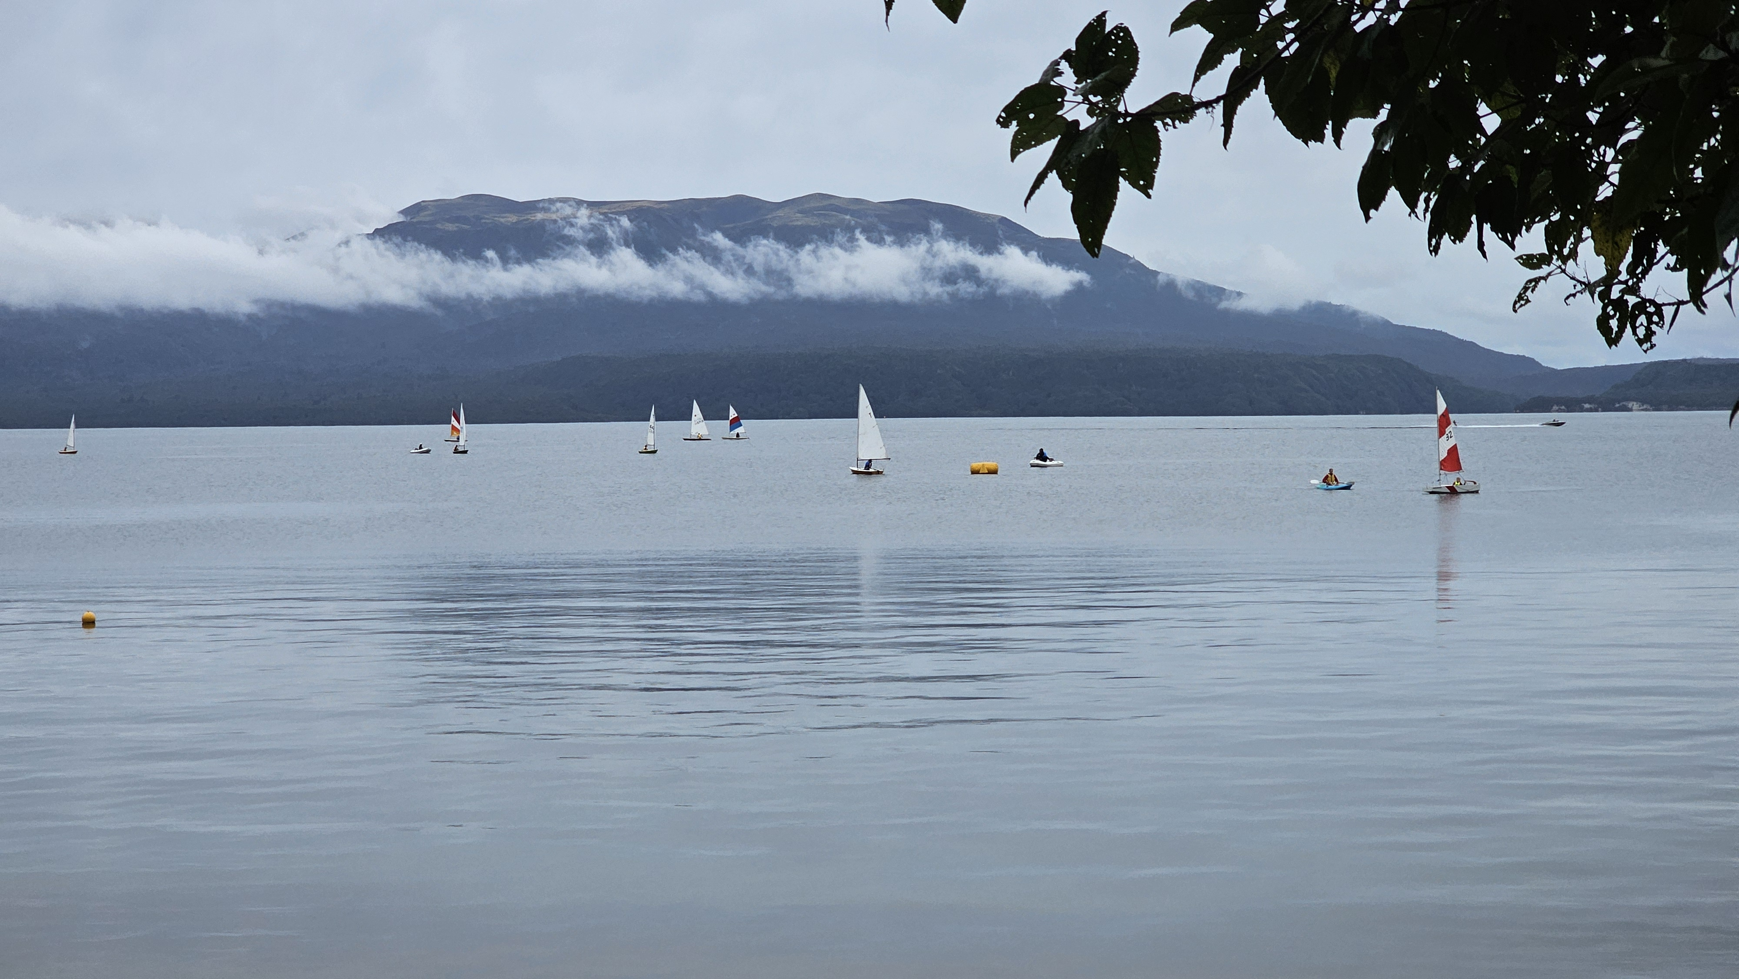

Slide 2
Purpose of LTRA Submission
Funding for the Lake Tarawera Wastewater Reticulation Scheme
We request that the Regional Council endorses that a fair contribution from property owners is 50% of the project cost and that Council provides additional funding to the scheme to reduce the cost share to owners.

Slide 3
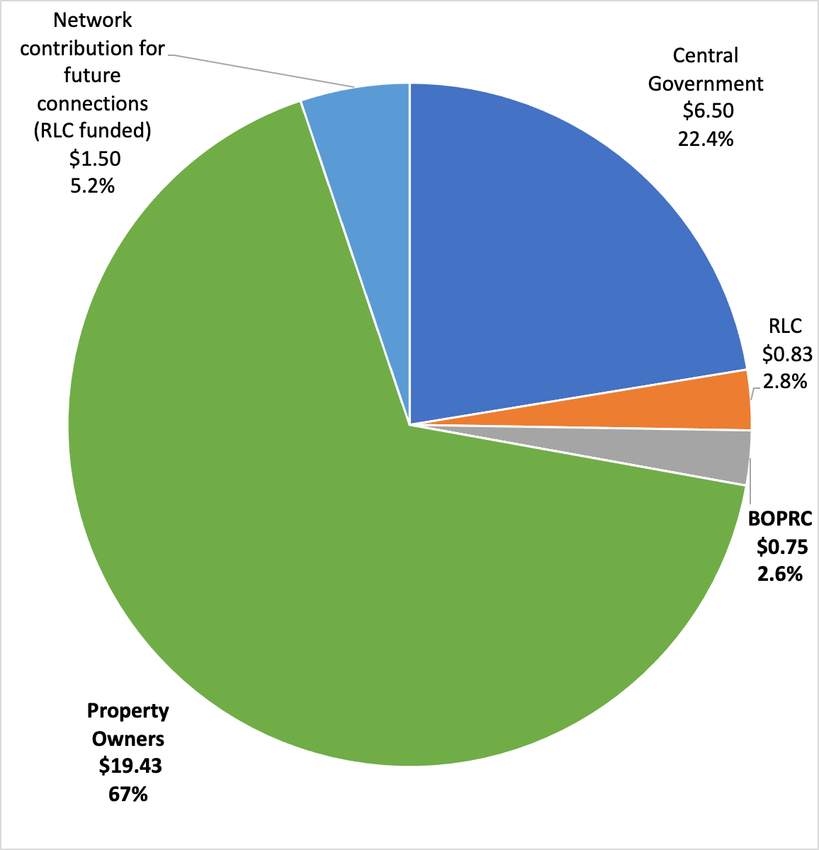
Current Funding
The cost of the project is $29m
Existing subsidies from BOPRC, RLC and central government total $8.1m.
The 446 property owners would fund 67% of the project cost.
That is approx. $50,000 per property (including GST).

Slide 4
Lake Tarawera Wastewater Reticulation Scheme Cost and Funding
 | Cost | Stage | BOPRC Contribution | Property Owner Contribution
2014 | $13.8m | Feasibility
2018 | $15m - $19m | Funding established | 5.0% - 3.9% | 42% - 52%
2021 | $22.5m | Proposal to Owners | 3.3% | 57%
2024 | $29m | Committed contracts | 2.6% | 67%

Slide 5
Matters to be considered by BOPRC in allocating funding to the scheme
Regional Council is being requested to contribute a greater share of the capital cost of a scheme that enhances lake water quality.
BOPRC response to LTRA submission to 2021 LTP
‘We consider that this funding contribution ($750,000) towards a service that is the primary responsibility of Rotorua Lakes Council is the appropriate amount’.

Slide 6
Matters to be considered by BOPRC in allocating funding to the scheme
Council has a fundamental role in promoting the social, economic, environmental and cultural well-being of communities in the present and the future.
It is hard to imagine a funding initiative that better aligns with this role than the enhancement of lake water quality in the Region.

Slide 7
Matters to be considered by BOPRC in allocating funding to the scheme
The scheme is providing a superior lake water quality outcome than that prescribed by Council’s OSET requirements.
Council should happily recognise the core benefit of a scheme which totally eliminates wastewater discharges to the lake forever, through its share of scheme funding.

Slide 8
Matters to be considered by BOPRC in allocating funding to the scheme
Council is a direct economic beneficiary of the reticulation scheme versus the alternative of implementing OSET replacement under its own management, and then managing quality and compliance for individual on-site wastewater systems in perpetuity.
Council’s contribution should recognise this direct economic benefit.

Slide 9
Matters to be considered by BOPRC in allocating funding to the scheme
Those who gain from improved water quality of iconic Lake Tarawera - a very wide range of people locally, regionally, nationally, and internationally.
The wide range of beneficiaries must be recognised through the equitable sharing of the cost of the scheme by local councils and central government and property owners.

Slide 10
LTRA request to Regional Council
LTRA requests that the Regional Council endorses that a reasonable contribution from property owners is 50% of the project cost and that Council both provides additional funding to the scheme and collaborates with Rotorua Lakes Council and central government to reduce the cost share to owners.
Additional funding of $6.1m is required.
The 446 property owners would fund 50% of the project cost.
That equates to about $37,000 per property (including GST), which would be capped.

Slide 11
Matters to be considered by BOPRC in allocating funding to the scheme
Regional Council is being requested to contribute a greater share of the capital cost of a scheme that enhances lake water quality.
Council has a fundamental role in promoting the social, economic, environmental and cultural well-being of communities in the present and the future.
The scheme is providing a superior lake water quality outcome than that prescribed by Council’s OSET requirements.
Council is a direct economic beneficiary of the reticulation scheme versus the alternative of implementing OSET replacement under its own management, and then managing quality and compliance for individual on-site wastewater systems in perpetuity.
Those who gain from the improved water quality of iconic Lake Tarawera are a very wide range of people locally, regionally, nationally, and internationally.

